Slide 1

Credit card fraud detection
By Shivani Jadhav

Slide 2
Agenda
INTRODUCTION
Project approach
Data loading & initial exploration
Feature & target Selection
Data splitting & model training
MODEL EVALUATION

Slide 3
INTRODUCTION
This project develops a machine learning model to detect fraudulent credit card transactions. Using Logistic Regression, we analyze historical transaction data to differentiate between legitimate and fraudulent activities, aiming to enhance financial security.
INTRODUCTION

Slide 4
Project Approach
Dataset : ‘creditcard.csv’
Contains features of transactions
A binary classification target
(‘0 = Non-Fraud’,’1 = Fraud’)
Approach
Logistic regression model
Model evaluation using accuracy, precision, recall and key metrics

Slide 5
Data Loading & Initial Exploration
Dataset imported
Class imbalance check
Missing values
Credit card transactions data loaded using ‘pandas’
Reviewed distribution of ‘fraud’ vs ‘non-fraud’ transactions
df[‘class’].value_counts()
Confirmed that no missing values are present​
df.isnull().sum()

Slide 6

Feature & target selection
Feature Selection : Selected all transaction related columns using
X = df.iloc[:,:-1]
Target Selection : Selected the last column as the target ( fraud indicator) using
y = df.iloc[:,-1]
6

Slide 7
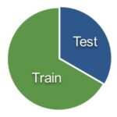


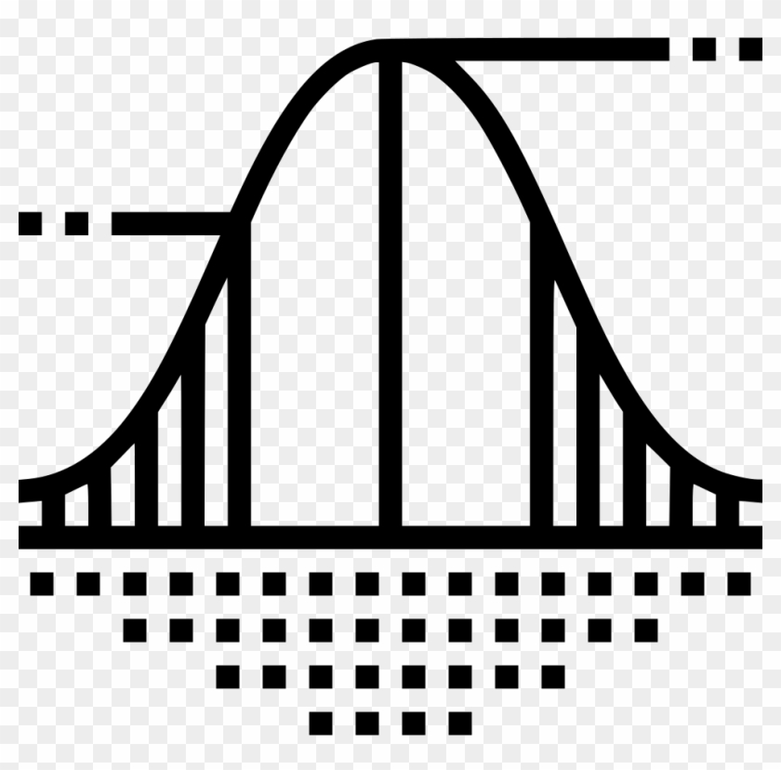
Data Splitting & Model Training
Training 70% & testing 30 %
Logistic Regression
Train-test split
Model Used
LR is chosen for its simplicity and effectiveness in binary classification task
log.fit(x_train, y_train)
Training Process
Logistic Regression

Slide 8
Model Evaluation
Critical for accessing model performances, especially in the context of imbalanced data
Prediction on test set
Generated predictions for the test data
y_pred=log.predict(x_test)
Training Accuracy
Evaluated to ensure the model learns the pattern
log.score(x_train,y_train)
Testing Accuracy
Checked for model performance on unseen data
log.score(x_test,y_test)
Showed precision, recall, f1 score for both fraud and non-fraud classes
Detailed Evaluation
Classification Report

Slide 9
THANK
YOU

